Slide 1


3D Car Driving game
COMP5411 Project
By: Gao Shenlai Yan Nuoyuan

Slide 2
Design
First-Person Mode: Users can control the car running on the map. To win more scores, the car need to chase and “eat” those bubbles moving around the map.
Third-Person Mode: Users can move the camera to every corner of the map to check the rendering detail.
Users can customize the property of the height field such as height interval and line width from the Graphic User Interface.
Platform & Tool: WebGL, Three.js, Yarn

Slide 3
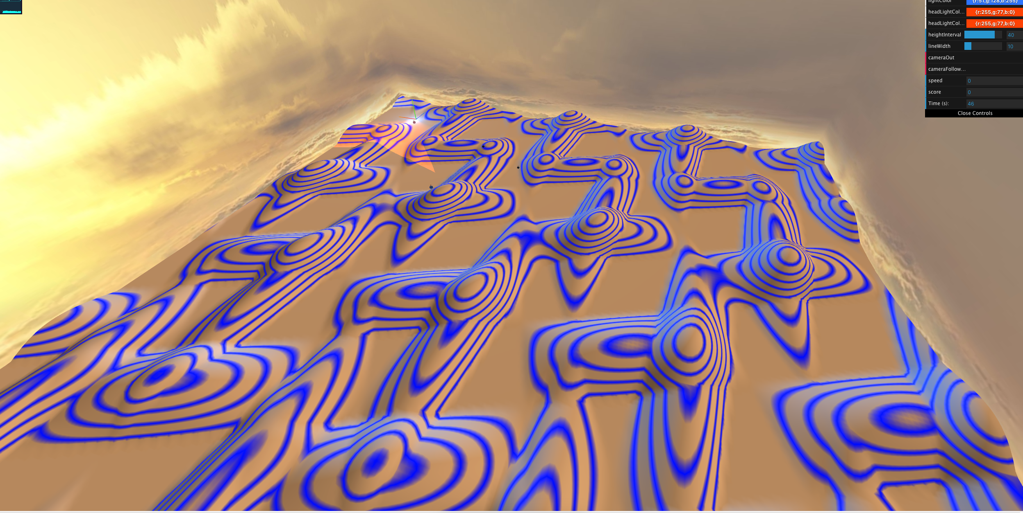
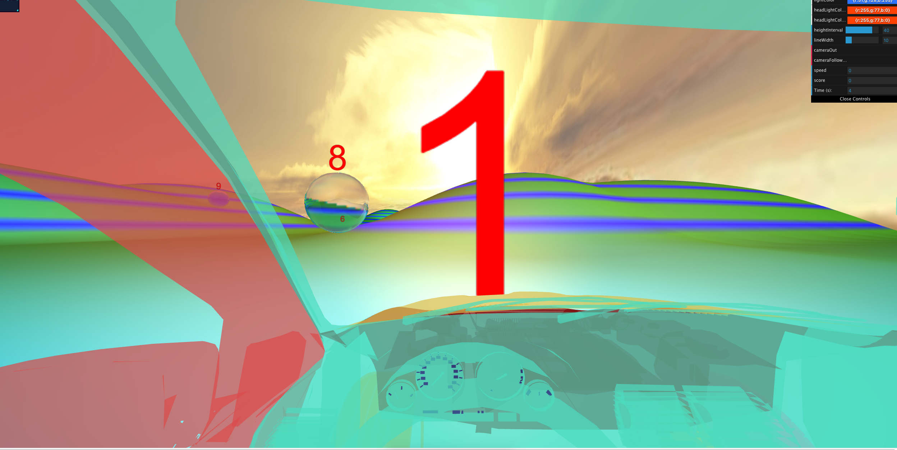
Challenges
Skybox
Height field generation
Directional light and Point light lighting on height field
Headlights projective lighting
Horizontal contour lines
Transparent bubbles
Proper car control and bubble movement control

Slide 4
IMPLEMENTATION
Skybox
A sky box surrounding the map with proper textures which are the images from the Internet.

Slide 5
IMPLEMENTATION
Height Field Generation
To achieve a good shading effect, the height field should be smooth with proper complexity, so that it won’t be boring or hard to render.
Here, it is just simply a gird of points with different height determined by their (x, y) coordinates with a formula involving some triangular functions.

Slide 6
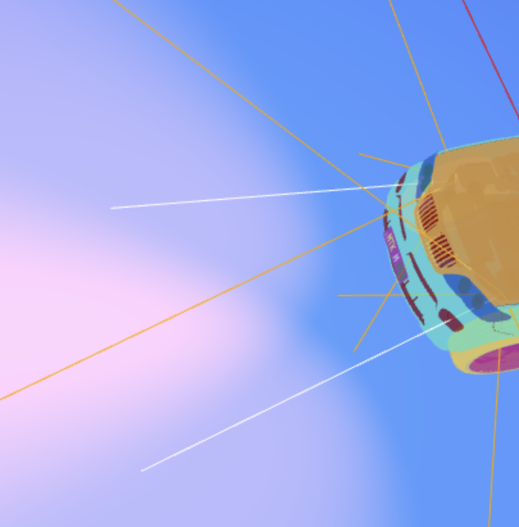
IMPLEMENTATION
Height Field Lighting
Phong illumination is used for a point light that will follow the car and a directional light to light up the general field.
Two headlights added with projective lighting.
Add two cameras as headlights.
gl_Position = projectionMatrix * modelViewMatrix * vec4(position, 1.0);
projectiveCoordinates = headlightProjectionMatrix * headlightModelViewMatrix * vec4(position, 1.0);
Pass two matrix to shader to determine whether current fragment should be in fustrum to be lighted.

Slide 7
IMPLEMENTATION
Horizontal Contour Lines
The blue lines are horizontal contour lines.
Pass the position from vertexShader to fragmentShader by varying variables and draw by height of current position.

Slide 8
Implementation
Transparent Bubble
We took reference on this example to create our bubble https://stemkoski.github.io/Three.js/Bubble.html
Those bubbles can move automatically. Once the car collides on the bubble, the number of score showing on the bubble will be added.

Slide 9
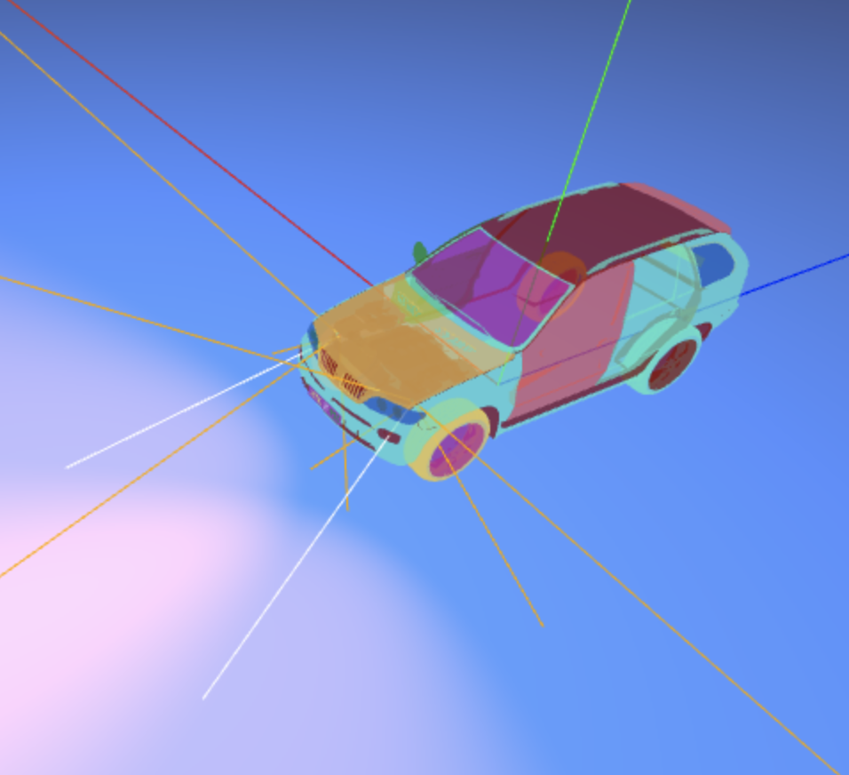
Implementation
Car
We loaded an obj and mtl files as our car object. To make it more fancy, we added two head lights in the front of the car.

Slide 10
Demo

